Slide 1
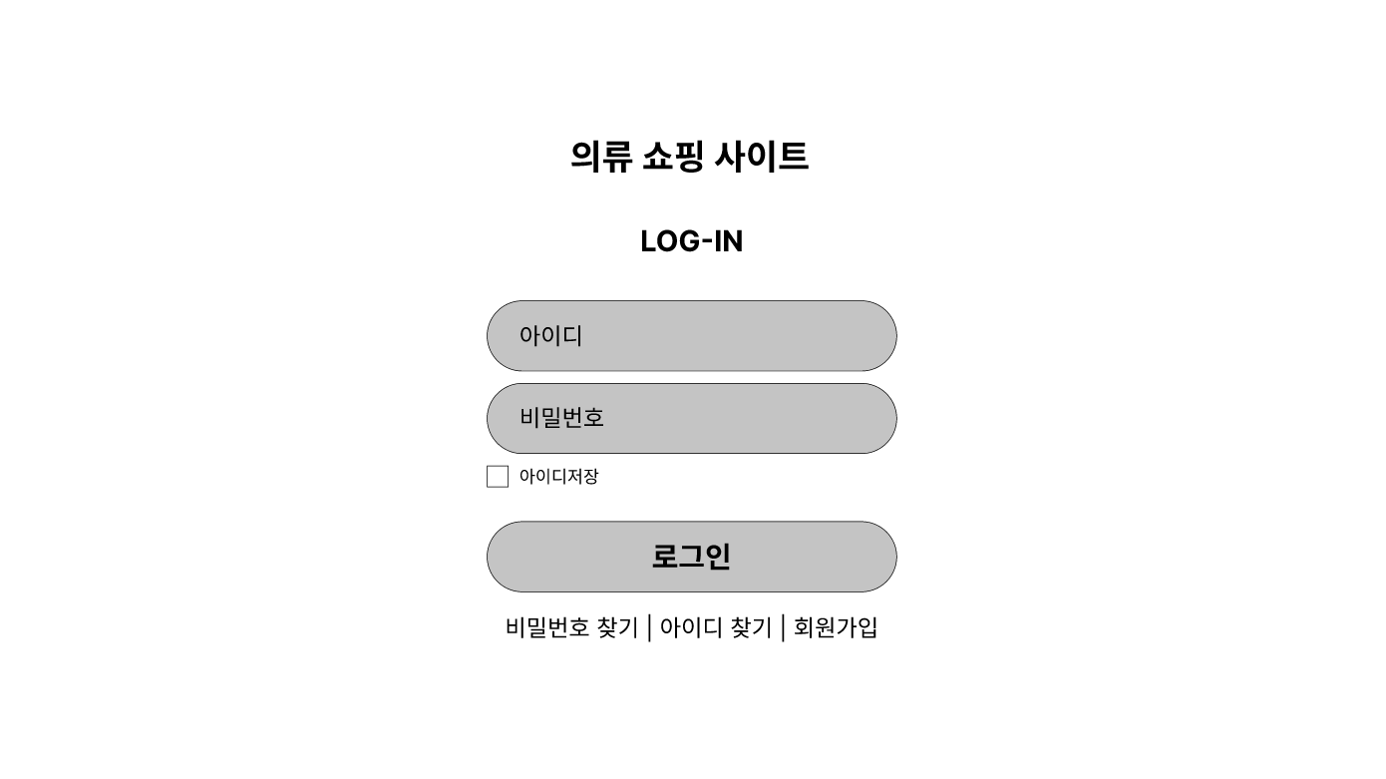
Notes:
https://www.figma.com/file/7yqQladPUY8lPHgRJMtCx4/%EB%A1%9C%EA%B7%B8%EC%9D%B8?node-id=0%3A1

Slide 2
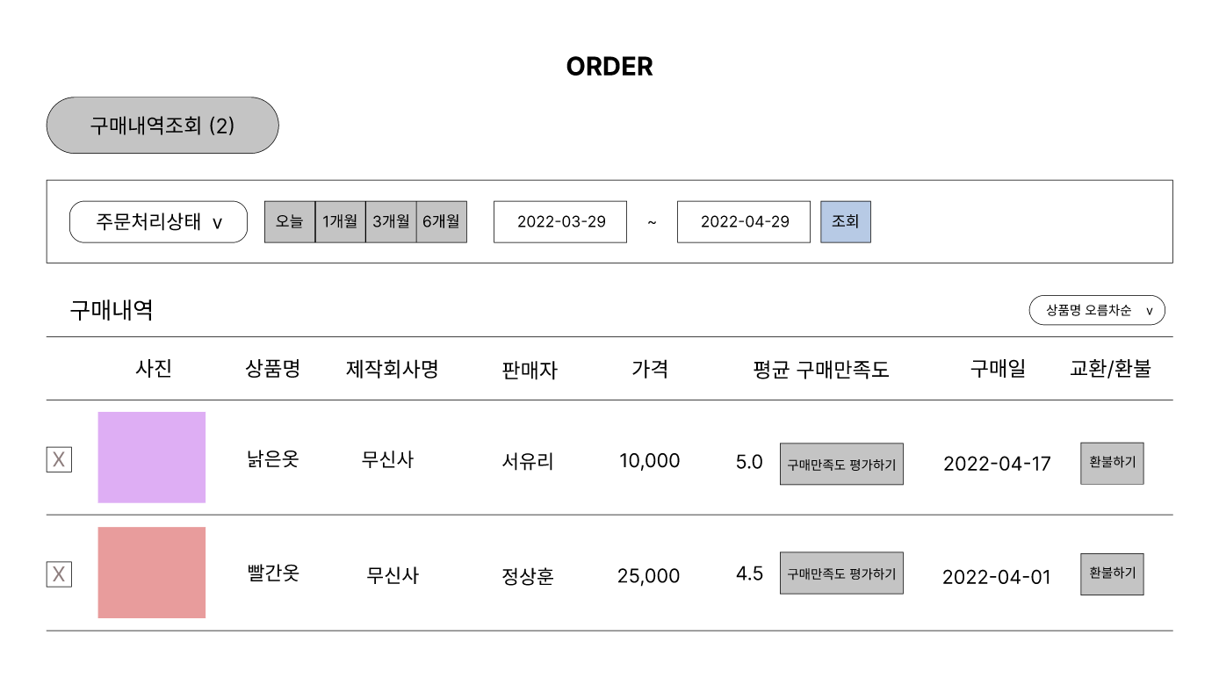
Notes:
https://www.figma.com/file/Js3gwBtOm3Vd3GQomcOFcS/%EA%B5%AC%EB%A7%A4%EB%82%B4%EC%97%AD-%EC%A1%B0%ED%9A%8C?node-id=0%3A1

